Slide 1
SoC with the Satellite Navigation Unit based on the single-core Rocket chip
Khabarov Sergey,
Nefedov Denis

Slide 2
Who we are:
The startup company that emerged with the support of the “Laboratory of Modeling and Design of Special Computer Systems Architectures” of Moscow Institute of Physics and Technology (MIPT)
Goal:
To become a first prominent private ASIC design center in CIS region, that provides its customers their IP integration into SOC designs.

Slide 3
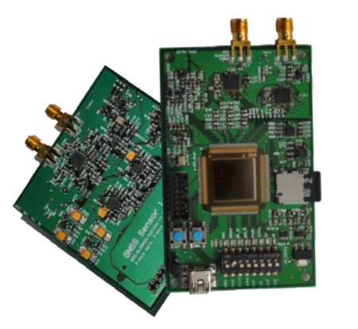
What we already have: Hardware
RF-mezzanine card for the FPGA prototypes (Virtex6, Kintex7 KC705)
Silicon verified GNSS IP code and ASIC development board with LEON3 CPU inside.
FPGA prototypes including based on the Rocket-chip CPU:
https://github.com/sergeykhbr/riscv_vhdl.git

Slide 4
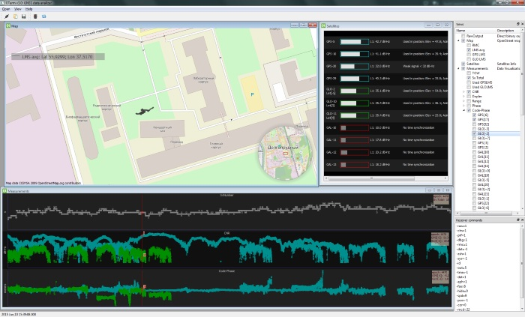
What we already have: Software
Universal receiver firmware with the plug-n-play support for different targets: ASIC, FPGA and behavior simulation.
Host application for data analysis
See details:
www.gnss-sensor.com

Slide 5
ASIC design complexity:
Total gate count: 6.2M gates
32 x Channels GNSS engine: 1.4M gates
3 x Fast Search Engines (GPS/Glonass/Galileo): 1.5M gate
Internal SRAM: 2.2M gates
CPU with MMU and Caches: 540K gates

Slide 6
What we are doing now:
Demonstration of portability of the Satellite Navigation IP.
Learn the new CPU architecture.

Slide 7
Rocket-chip based SoC goals:
Modular
Portable
Written in VHDL
Standard interfaces
CAD tool independence
Uniform method for HW & SW debug
Plug-n-play support
Transfer design on RISC-V architecture using all the best ideas of the GPL licensed ‘grlib’ library.

Slide 8
Overview of the Rocket-chip based mockup
Available on: https://github.com/sergeykhbr/riscv_vhdl.git

Slide 9
Portability:
Process portability achieved through block wrappers.
Definition of 'virtual' components (PLL, IO pads, memory etc.).
Size, technology etc. are set through VHDL generics.
Technology specific mega-cells are instantiated with VHDL generate statements.
Modular design - new technology easily added
Support of both ASIC and FPGA technologies
Example:
https://github.com/sergeykhbr/riscv_vhdl.git

Slide 10
CAD tools independence:
Robust coding style – 'least common denominator‘ inherited from GRLIB.
Project supports all major CAD tools.
Mentor, Cadence, Synopsys
ISE Studio, Vivado, Quartus.
New CAD tool easily added but needs thorough testing.

Slide 11
Plug and Play
Inherited from GRLIB method to quickly assemble a complex SOC design.
PCI-style plug&play support for AMBA (AXI4) configuration.
Device, ID, Vendor ID and version identification.
Address and interrupt configuration
Cacheability, pre-fetch information
Several memory BARs per slave device.
Configuration set through VHDL generics
Plug&play information routed in sideband signals accessible via dedicated slave device on system bus.
Fully compatible with AMBA AXI4.

Slide 12
UART output example
[uart0] # RISC-V: Rocket-Chip demonstration design
[uart0] # HW version: 0x20151217
[uart0] # Target technology: Virtex6
[uart0] # AXI4: slv0: GNSS Sensor Ltd. Boot ROM
[uart0] # 0x00000000...0x00001FFF, size = 8 KB
[uart0] # AXI4: slv1: GNSS Sensor Ltd. FW Image ROM
[uart0] # 0x00100000...0x0013FFFF, size = 256 KB
[uart0] # AXI4: slv2: GNSS Sensor Ltd. Internal SRAM
[uart0] # 0x10000000...0x1007FFFF, size = 512 KB
[uart0] # AXI4: slv3: GNSS Sensor Ltd. Generic GPIO
[uart0] # 0x80000000...0x80000FFF, size = 4 KB
[uart0] # AXI4: slv4: GNSS Sensor Ltd. Generic UART
[uart0] # 0x80001000...0x80001FFF, size = 4 KB
[uart0] # AXI4: slv5: GNSS Sensor Ltd. Interrupt Controller
[uart0] # 0x80002000...0x80002FFF, size = 4 KB
[uart0] # AXI4: slv6: GNSS Sensor Ltd. GNSS Engine
[uart0] # 0x80003000...0x80003FFF, size = 4 KB

Slide 13
Repository features
Plug-n-play configuration module with the AXI interface.
Interrupt controller with the AXI interface either as UART and GPIO.
Project includes generic parameter allowing enable/disable L1toL2 interconnect (L2 cache).
GNSS related functionality was stubbed
SoC implements self-loading procedure from the Boot ROM just after reset (see next slide).
Constraints and ISE Studio projects files included.
This is ready-to-use SoC template for the Virtex6 and Kintex7 FPGA boards (ML605, KC705) that sequentially turns on/off LEDs and prints PnP information into UART.

Slide 14
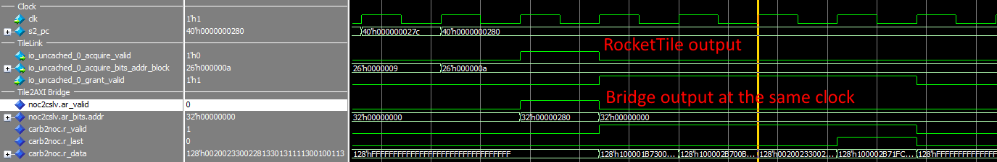
Memory access optimization
Single core.
L2 cache disabled
Read/Write access to the AXI peripheries for one clock cycle.
Burst read example
1 clock address request + 4 clocks burst operation

Slide 15
Boot procedure overview
Registers initialization.
Copying ROM FW Image into internal SRAM (total 512 KB available).
Go to SRAM entry point 0x10000000 in user mode.
Initialization of the “Interrupt Registers” by proper handler.
Initialization of the UART
Start main task.
Features:
Automatic Detection of the target (Simulation, FPGA).
Speed-up behavior simulation by selecting reduced registers values.
One firmware for all platforms.

Slide 16
Performance evaluation: SPARC-V8 (Leon3) vs RISC-V (Rocket)
General characteristics
Parameter | LEON3 | Rocket
Address/Data bits | 32/32 | 64/128
Cache L1/L2, FPU | Yes/No, No | Yes/No, No
memcpy, 8 KB block | 11.780 [clocks] | 14.630 [clocks]
GNSS critical task (14 channels) (a lot of branches, memory accesses) | 22 % of time | 25 % of time
GNSS positioning task (mathematical task) | 10 % of time | under estimation
Average idle time | 60 % | under estimation

Slide 17
Our next step
Producing SOC on 90 nm technology with the 256 channels GNSS engine.
Add L2/L3/L5 bandwidth support in GNSS Engine.
We have a lot of difficulties with the firmware debugging due to the lack of a concenient debugger and one general problem is:
Receiver’s firmware processing depends of the satellites constellation and noise condition.
So, we’ve decided to implement our own Debug Support Unit (DSU) on the system bus using experience with a similar device in GRLIB and own software with OS Windows support.

Slide 18
Debug HW/SW requirements
Multi-Core Debug protocol.
MCD interface (instead of gdb) potentially supported by Trace32 (Lauterbach).
http://www.lauterbach.com/frames.html?mcd_api.html
Hardware and simulator targets support.
Single core Rocket-chip SOC (FPGA and ASIC implementations)
Implement Rocket CPU module for the Intel Simics simulator.
Independent transport layer.
UDP transport layer
JTAG support later
VHDL implementation of the SOC modules.

Slide 19
Real HW debug structure

Slide 20
Debug description
Ethernet MAC with EDCL.
At the first step will be used refactored GRETCH 10/100 Ethernet MAC from the GRLIB library.
EDCL specially developed module providing read/write access to the AXI bus through Ethernet using an UDP based protocol.
UDP messages format maximum complies to the JTAG protocol.
2 Common requests (JTAG IRs): Address and Data.
Data binary string encoded:
Read/Write access flag
Memory ID (Register, Physical, Virtual, CSRs or other)
Offset
Burst length
Payload

Slide 21
Ideal simulator in our opinion
We have enough experience to develop functional model of the RISC-V CPU using Simics API. It depends on the demands.
Lauterbach has to become interested to support new architecture.

Slide 22
That’s all
Thank you for your attention.
GNSS related information:
www.gnss-sensor.com
Open source repository with the VHDL SOC template:
https://github.com/sergeykhbr/riscv_vhdl.git

